Slide 1
TASK 4 PPT
Objective: Design an interactive dashboard for business stakeholders.
Tools: Power BI / Tableau
Database: fictional ZEE MART ECOMMERCE SALES
Brief: Created a power BI dashboard that includes
Sum of profit by month-stacked column chart
Sum of profit by sub category-stacked bar chart
Sum of quantity by category-pie chart
Sum of quantity by quarter(date)- donut chart
cards representing sum of amount , sum of quantity, sum of profit.

Slide 2
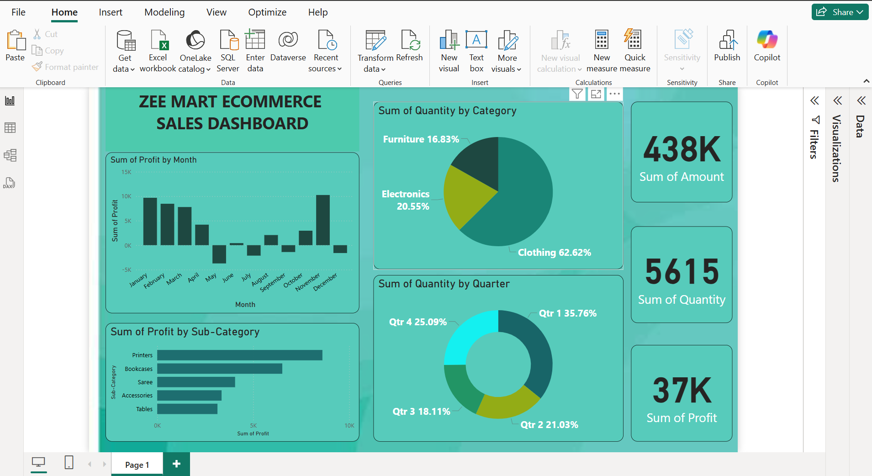
Dashboard

Slide 3
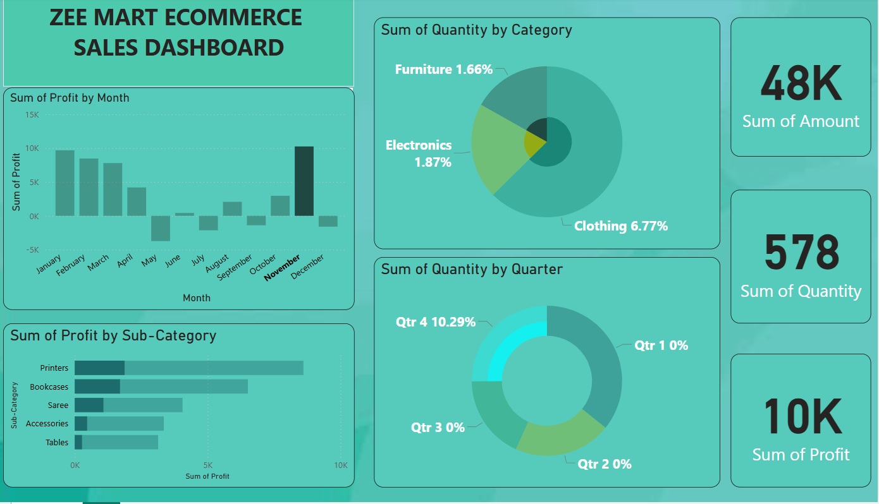
Readings of highest profit

Slide 4
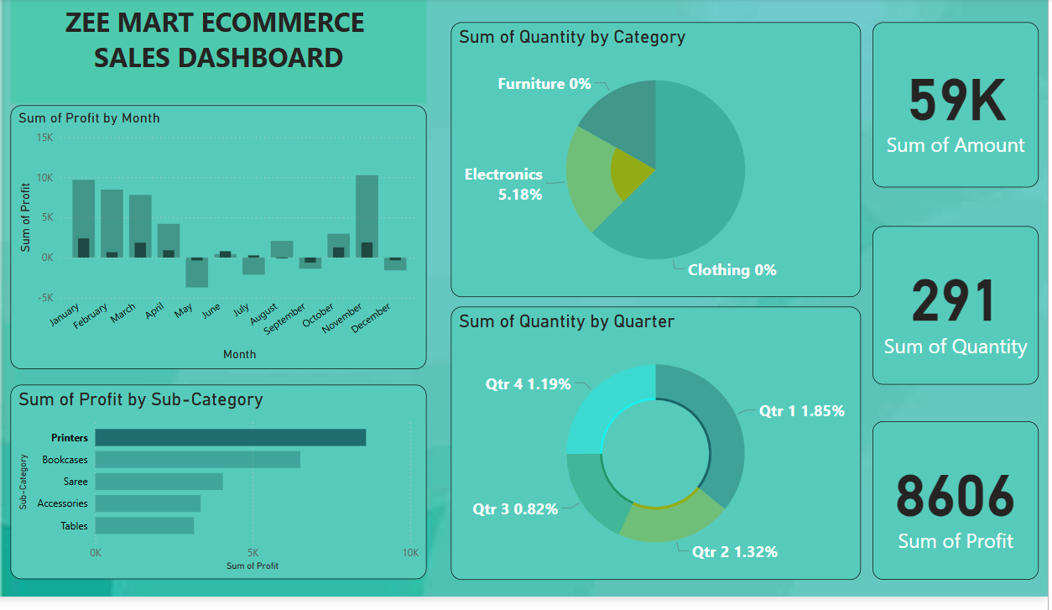
Sum of profit by highest selling sub-category

